Slide 1
Natural Language Processing Specialization Question Answering with BERT and T5
(2021 Deeplearning.ai)
YangXi’s Reading Notes

Slide 2
Transfer Learning (TL) in NLP
TL stores knowledge gained from one task and applies it to a different task
Feature-based learning
From the pre-training task, generate features, such as word embeddings
Use these features to train a new model to perform a new task
Fine-tuning
From the pre-training task, store the pre-trained model; then adjust the model to perform the downstream task
Gradual unfreezing: unfreeze the layers one at a time, from the last layer
Adapter layer: fix the weights, and add new NN to each feed-forward and each block of the transformer
The new NN should have equal input and output dimensions, so they can be inserted without any structural change
Usage of unlabeled data in Pre-Training
Usually, there are much more unlabeled data than labeled data
English Wikipedia ~ 13GB
Colossal Clean Crawled Corpus ~ 800 GB
You can use unlabeled data in pre-training for a self-supervised task
Then you can transfer the model to learn a new task, with small set of labeled data
Advantages of TL
Reduce training time by using a pre-trained model
Improve performance
Require small datasets

Slide 3
ELMo ➔ GPT ➔ BERT ➔ T5
CBOW (Continuous Bag of Words)
Predict the central word with adjacent context within a fixed window
Cannot look at all context before and after the central word
ELMo: Full context using RNN with Bi-directional LSTM
GPT (Open AI): using transformer with a decoder
Only uni-directional: only use context on one side
BERT (Bidirectional Encoder Representation of Transformers)
Multi-Mask Language Modelling: predict multiple missing words in the sentence
Can predict the next sentence, instead of just the next word
T5
Use encoder-decoder as in the original transformer architecture
Bi-directional context
Multi-Task training: learn multiple tasks in one model

Slide 4
BERT Overview
BERT framework makes use of transfer learning
Pre-training: train the model using unlabeled data for two tasks
Masked Language Modeling
Choose 15% of the tokens at random
Mask them 80% of the time
Replace them with a random token 10% of the time
Keep as-is 10% of the time
Learn to predict the original token, with cross-entropy loss
Next Sentence Prediction
Given two sentence, predict whether they follow one another
Fine-tuning: fine-tune the model using labeled data of downstream tasks
BERT also makes use of
Multi-layer bidirectional transformer
Segment embeddings and Positional embeddings
The BERT_base model
12 layers (12 transformer blocks)
12 attention heads
110 million parameters

Slide 5
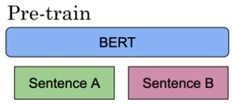
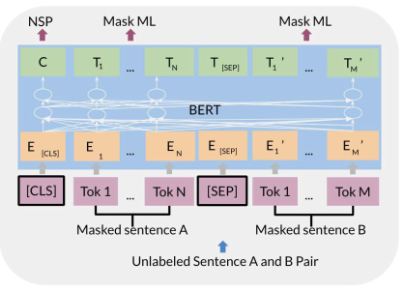
BERT Input and Objectives
Input representations
The final input embeddings are the sum of
Position embedding: position in the sentence
Segment embedding: to tell which sentence it is
Token embedding
Word embedding
CLS token: indicate the start of every input
SEP token: indicate the end of the sentence
BERT Objectives and Loss Functions
Multi-Mask LM: cross-entropy loss
Next Sentence Prediction (NSP): binary loss

Slide 6
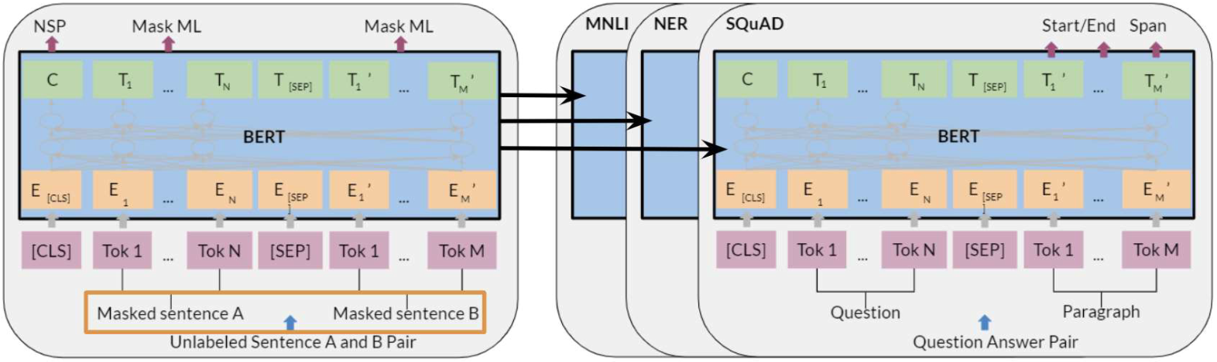
Fine-tuning BERT
You can replace sentence A, sentence B and the labels for downstream tasks
SQuAD (Question-Answer): replace sentence A/B to question/paragraph, and label with start and end of the answer
Sentiment analysis: replace sentence A with a text, and B with NULL
MNLI: A – hypothesis, B – premise
NER: A – sentence, B – entities
Paraphrase: A – sentence, B – paraphrase
Summarization: A – article, B – summary

Slide 7
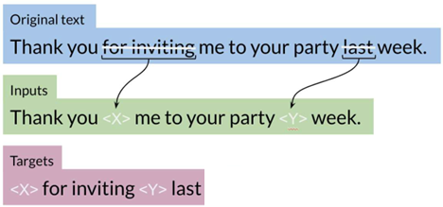
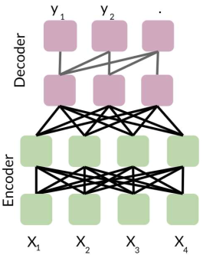
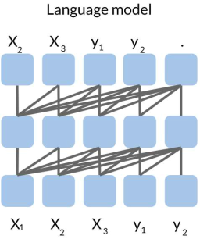
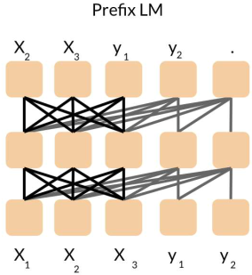
T5 (Text-to-Text Transformer) Framework
T5 framework also makes use of transfer learning
Model Architecture
Use encoder-decoder stack
12 transformer blocks each; 220 million parameters
Pre-training
Masked Language Modelling
Represent masked words with tokens, such as <X>, <Y>, …
Predict what are the masked words (in a sequence)
See notes below the page for an example
Note the for BERT the loss is on the mask (encoder), while for T5 the loss is on the target (decoder)
Usage of attentions in various models
Encoder-Decoder
Fully visible attention in encoder
Causal attention in decoder
Language Model
Concatenate inputs and targets
Casual masking throughout
Prefix Language Model
Fully visible masking over the inputs
Casual attention for the rest
Notes:
An example of inputs and targets for pre-training T5 with masked language modelling:
inputs: Beginners BBQ Class Taking Place in Missoula! Do you <Z> to get better at making delicious BBQ? You will have the opportunity, put this on your calendar now. Thursday, September 22nd join World Class <Y> Champion, Tony Ba <X> from Lone <W>e Rangers. He will be teaching <V> beginner level class for everyone who wants <U> get better with their culinary <T>. He<S> teach you everything you<R> to know to compete in a KCBS BBQ competition, including techniques, <Q>, timelines,<P> selection and <O>, plus smoker and fire information. The cost to be in the class is $35 per<N> and for <M>s it <L> free. <K>d in <J> will be either a t-shirt or <I>pron and you will be tasting samples of each meat that is prepared.
targets: <Z> want <Y> BBQ <X>lay <W>star Smok <V>a <U> to <T> skills<S> will<R> need <Q> recipes<P> meat <O> trimming<N> person, <M> spectator <L> is <K> Include <J> the cost <I>a

Slide 8
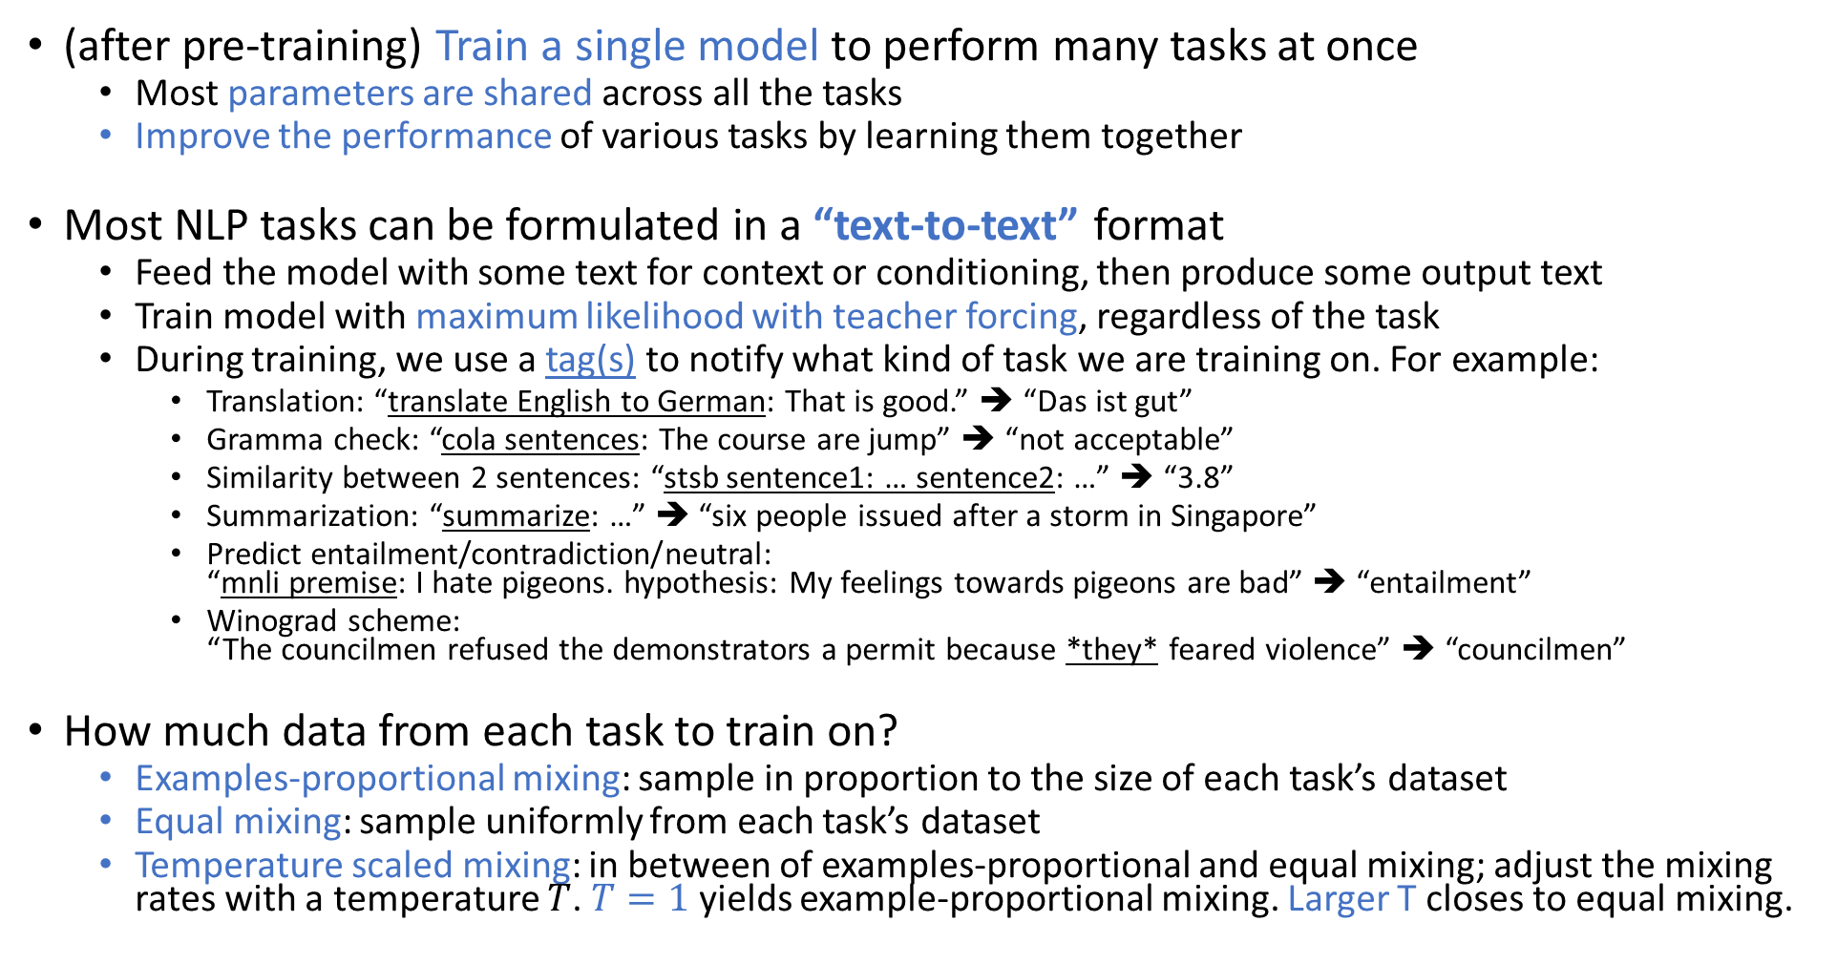
Multi-Task Training Strategy
(after pre-training) Train a single model to perform many tasks at once
Most parameters are shared across all the tasks
Improve the performance of various tasks by learning them together
Most NLP tasks can be formulated in a “text-to-text” format
Feed the model with some text for context or conditioning, then produce some output text
Train model with maximum likelihood with teacher forcing, regardless of the task
During training, we use a tag(s) to notify what kind of task we are training on. For example:
Translation: “translate English to German: That is good.” ➔ “Das ist gut”
Gramma check: “cola sentences: The course are jump” ➔ “not acceptable”
Similarity between 2 sentences: “stsb sentence1: … sentence2: …” ➔ “3.8”
Summarization: “summarize: …” ➔ “six people issued after a storm in Singapore”
Predict entailment/contradiction/neutral: “mnli premise: I hate pigeons. hypothesis: My feelings towards pigeons are bad” ➔ “entailment”
Winograd scheme: “The councilmen refused the demonstrators a permit because *they* feared violence” ➔ “councilmen”
How much data from each task to train on?
Examples-proportional mixing: sample in proportion to the size of each task’s dataset
Equal mixing: sample uniformly from each task’s dataset
Temperature scaled mixing: in between of examples-proportional and equal mixing; adjust the mixing rates with a temperature $T$. $T=1$ yields example-proportional mixing. Larger T closes to equal mixing.

Slide 9
GLUE Benchmark
General Language Understanding Evaluation (GLUE)
One of the most commonly used benchmarks in NLP
A collection used to train, evaluate, analyze natural language understanding systems
It has lots of datasets, each with different genres / sizes / difficulties
For co-reference resolution, sentiment analysis, question answering, etc
With access to many datasets, you can make use of transfer learning
It has a leaderboard to compare your model with others
Model Evaluation
Models are evaluated on the following tasks:
Grammatical correctness, sentiment analysis, paraphrase, similarity, question duplications, answerable (if a question is answerable), contradiction, entailment, Winograd schema (co-reference)
Model agnostic: it doesn’t matter which model you use

Slide 10
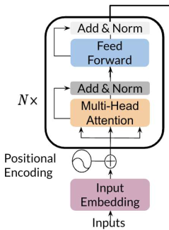
Question Answering
Two types of Question Answering
Context-based: Input a question and a context, the model finds the answer inside the context
Closed-book: Input a question, the model gives the answer without access to a context
Transformer Encoder
Encoder block
Residual(LayerNorm, attention, dropout)
Residual(feed_forward)
Feed forward block
LayerNorm ➔ dense ➔ activation ➔ dropout ➔ dense ➔ dropout
Context-based Q&A with T5
Load a pre-trained model
Process data to get the required inputs and outputs
Input: “question: Q context: C”
Target: “A”
Fine tune the model on the new task (new data)
Predict using the new model

Slide 11
Tokenization – SentencePiece
Tokenization considerations
Level of granularity
Raw text: “tokens are tricky”
Words: tokens, are, tricky
Morphemes: token, s, _, are, _, trick, y
Phonemes: t, oʊ, k, ə, n, z, _, ɑː, _, ˈt, r, ɪ, k, i
Character: T, o, k, e, n, s, _, a, r, e, _, t, r, i, c, k, y
Language
Most European languages use space to separate words
Some Asian languages do not have spaces between words
Practical memory limitations vs. coverage
Handle of Unicode
SentencePiece (2018 Google)
A simple and language independent subword tokenizer and detokenizer
SentencePiece ensures lossless tokenization
After tokenize and detokenize, the original position of spaces are preserved
But tabs and newlines are converted to spaces
Group Unicode characters using either a unigram LM or byte-pair-encoding (BPE)
Use standard normalization form of Unicode (NFKC)
By default, -1 is for begin of sentence <s>, 0 is for <pad>, 1 is for end of sentence </s>, 2 is for <unk>

Slide 12
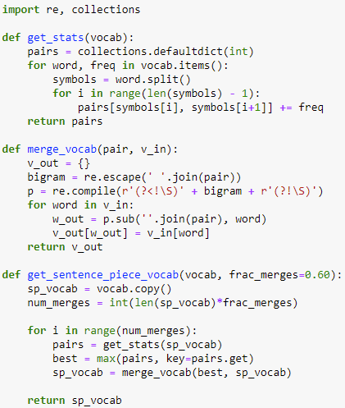


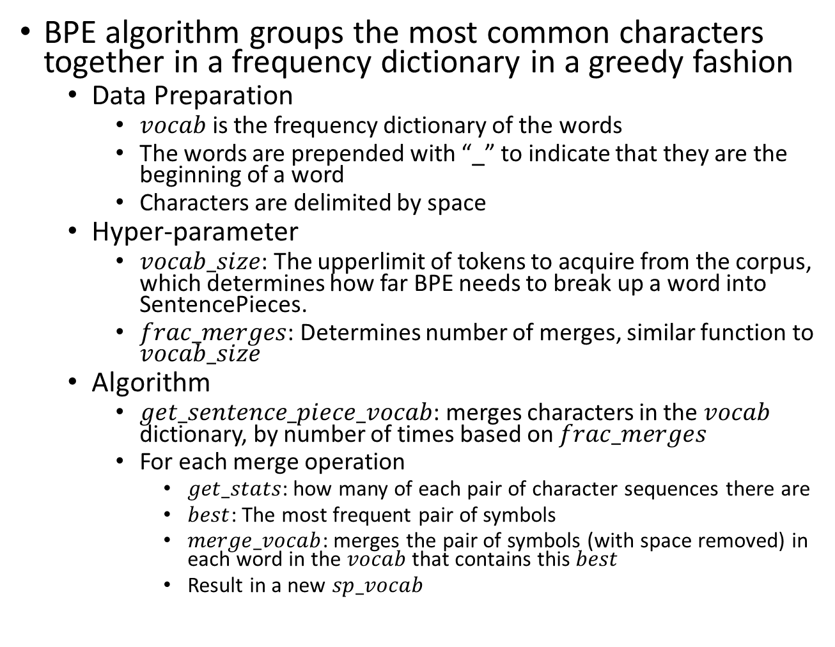
Tokenization – Byte Pair Encoding (BPE)
BPE algorithm groups the most common characters together in a frequency dictionary in a greedy fashion
Data Preparation
$vocab$ is the frequency dictionary of the words
The words are prepended with “_” to indicate that they are the beginning of a word
Characters are delimited by space
Hyper-parameter
$vocab_size$: The upperlimit of tokens to acquire from the corpus, which determines how far BPE needs to break up a word into SentencePieces.
$frac_merges$: Determines number of merges, similar function to $vocab_size$
Algorithm
$get_sentence_piece_vocab$: merges characters in the $vocab$ dictionary, by number of times based on $frac_merges$
For each merge operation
$get_stats$: how many of each pair of character sequences there are
$best$: The most frequent pair of symbols
$merge_vocab$: merges the pair of symbols (with space removed) in each word in the $vocab$ that contains this $best$
Result in a new $sp_vocab$

Slide 13
Hugging Face
An ecosystem to build, train and deploy models powered by the reference open source in machine learning
Consist of many tools like transformers, datasets, tokenizers, … etc
Hugging hub: a platform to collaborate on ML models and datasets
Model hub: host 15000+ community contributed models
Filter models by task, library (PyTorch, Tensorflow …), dataset, language (en, zh, …), license
Also allow you to push models and weights without requirement of any library
Hosted Inference API for members to play with the model

